Slide 1
Business Problem
Import Packages
import numpy as np
import pandas as pd
from scipy.stats import kstest
import matplotlib.pyplot as plt
%matplotlib inline
import plotly.express as px from wordcloud import WordCloud import seaborn as sns sns.set(style='whitegrid') import warnings
warnings.filterwarnings('ignore')
from sklearn.preprocessing import PowerTransformer
Create UDFs
# Create Data audit Report for continuous variables
def continuous_var_summary(x):
return pd.Series([x.count(), x.isnull().sum(), x.sum(), x.mean(), x.median(),
x.std(), x.var(), x.min(), x.quantile(0.01),
x.quantile(0.05),
x.quantile(0.10),x.quantile(0.25),x.quantile(0.50),x.quantile(0.75),
x.quantile(0.90),x.quantile(0.95),
x.quantile(0.99),x.max()],
index = ['N', 'NMISS', 'SUM', 'MEAN','MEDIAN',
'STD', 'VAR', 'MIN', 'P1',
'P5' ,'P10' ,'P25' ,'P50' ,'P75' ,'P90'
,'P95' ,'P99' ,'MAX'])
Import Data
df=pd.read_csv('E:/DataTrained\Intership_Flip Robo/Projects/Cause of Death/archive/cause_of_deaths dataset.csv')
df
 | Country/Territory | Code | Year | Meningitis | \
0 | Afghanistan | AFG | 1990 | 2159
1 | Afghanistan | AFG | 1991 | 2218
2 | Afghanistan | AFG | 1992 | 2475
3 | Afghanistan | AFG | 1993 | 2812
4 | Afghanistan | AFG | 1994 | 3027
... | ... | ... | ... | ...
6115 | Zimbabwe | ZWE | 2015 | 1439
6116 | Zimbabwe | ZWE | 2016 | 1457
6117 | Zimbabwe | ZWE | 2017 | 1460
6118 | Zimbabwe | ZWE | 2018 | 1450

Slide 2
6119 | Zimbabwe |  |  | ZWE | 2019 |  | 1450
 | Alzheimer's |  | Disease and Other Dementias |  |  |  |  | Parkinson's Disease |  |  | \
0 |  |  | 1116 |  |  |  |  | 371
1 |  |  | 1136 |  |  |  |  | 374
2 |  |  | 1162 |  |  |  |  | 378
3 |  |  | 1187 |  |  |  |  | 384
4 ... 6115 |  |  | 1211 ... 754 |  |  |  |  | 391 ... 215
6116 |  |  | 767 |  |  |  |  | 219
6117 |  |  | 781 |  |  |  |  | 223
6118 |  |  | 795 |  |  |  |  | 227
6119 |  |  | 812 |  |  |  |  | 232
Nutritional Violence \ 0 |  |  | Deficiencies 2087 |  |  | Malaria 93 | Drowning 1370 |  | Interpersonal
1538
1 |  |  | 2153 |  |  | 189 | 1391
2001
2 |  |  | 2441 |  |  | 239 | 1514
2299
3 |  |  | 2837 |  |  | 108 | 1687
2589
4 |  |  | 3081 |  |  | 211 | 1809
2849 ... ... 6115 |  |  | ... 3019 |  |  | ... 2518 | ... 770
1302
6116 |  |  | 3056 |  |  | 2050 | 801
1342
6117 |  |  | 2990 |  |  | 2116 | 818
1363
6118 |  |  | 2918 |  |  | 2088 | 825
1396
6119 |  |  | 2884 |  |  | 2068 | 827
1434
 | ... | Diabetes Mellitus |  |  | Chronic Kidney |  |  | Disease |  | Poisonings | \
0 | ... | 2108 |  |  |  |  |  | 3709 |  | 338
1 | ... | 2120 |  |  |  |  |  | 3724 |  | 351
2 | ... | 2153 |  |  |  |  |  | 3776 |  | 386
3 | ... | 2195 |  |  |  |  |  | 3862 |  | 425
4 ... 6115 | ... ... ... | 2231 ... 3176 |  |  |  |  |  | 3932 ... 2108 |  | 451 ... 381
6116 | ... | 3259 |  |  |  |  |  | 2160 |  | 393
6117 | ... | 3313 |  |  |  |  |  | 2196 |  | 398

Slide 3
6118 | ... | 3381 |  | 2240 |  |  | 400
6119 | ... | 3460 |  | 2292 |  |  | 405
 | Protein-Energy | Malnutrition |  | Road | Injuries | \
0 |  | 2054 |  |  | 4154
1 |  | 2119 |  |  | 4472
2 |  | 2404 |  |  | 5106
3 |  | 2797 |  |  | 5681
4 ... 6115 |  | 3038 ... 2990 |  |  | 6001 ... 2373
6116 |  | 3027 |  |  | 2436
6117 |  | 2962 |  |  | 2473
6118 |  | 2890 |  |  | 2509
6119 |  | 2855 |  |  | 2554
Chronic Respiratory |  |  | Diseases | \
0 |  |  | 5945
1 |  |  | 6050
2 |  |  | 6223
3 |  |  | 6445
4 ... 6115 |  |  | 6664 ... 2751
6116 |  |  | 2788
6117 |  |  | 2818
6118 |  |  | 2849
6119 |  |  | 2891
Cirrhosis and Other Diseases \ 0 |  |  | Chronic | Liver | Diseases 2673 | Digestive |  | 5005
1 |  |  |  |  | 2728 |  |  | 5120
2 |  |  |  |  | 2830 |  |  | 5335
3 |  |  |  |  | 2943 |  |  | 5568
4 |  |  |  |  | 3027 |  |  | 5739
... |  |  |  |  | ... |  |  | ...
6115 |  |  |  |  | 1956 |  |  | 4202
6116 |  |  |  |  | 1962 |  |  | 4264
6117 |  |  |  |  | 2007 |  |  | 4342

Slide 4
6118 |  | 2030 | 4377
6119 |  | 2065 | 4437
 | Fire, Heat, and Hot Substances | Acute Hepatitis
0 | 323 | 2985
1 | 332 | 3092
2 | 360 | 3325
3 | 396 | 3601
4 | 420 | 3816
... | ... | ...
6115 | 632 | 146
6116 | 648 | 146
6117 | 654 | 144
6118 | 657 | 139
6119 | 662 | 136
[6120 rows x 34 columns]
# This will enable us to see truncated columns pd.set_option('display.max_columns',None) df.head()
Country/Territory Code |  |  | Year | Meningitis | \
0 Afghanistan AFG |  |  | 1990 | 2159
1 Afghanistan AFG |  |  | 1991 | 2218
2 Afghanistan AFG |  |  | 1992 | 2475
3 Afghanistan AFG |  |  | 1993 | 2812
4 Afghanistan AFG |  |  | 1994 | 3027
 | Alzheimer's | Disease and Other Dementias |  |  | Parkinson's | Disease | \
0 |  | 1116 |  |  |  | 371
1 |  | 1136 |  |  |  | 374
2 |  | 1162 |  |  |  | 378
3 |  | 1187 |  |  |  | 384
4 |  | 1211 |  |  |  | 391
 | Nutritional | Deficiencies | Malaria | Drowning | Interpersonal | Violence
\
0 |  | 2087 | 93 | 1370 |  | 1538
1 |  | 2153 | 189 | 1391 |  | 2001
2 |  | 2441 | 239 | 1514 |  | 2299
3 |  | 2837 | 108 | 1687 |  | 2589
4 |  | 3081 | 211 | 1809 |  | 2849

Slide 5
 | Maternal Disorders | HIV/AIDS | Drug Use Disorders | Tuberculosis | \
0 | 2655 | 34 | 93 | 4661
1 | 2885 | 41 | 102 | 4743
2 | 3315 | 48 | 118 | 4976
3 | 3671 | 56 | 132 | 5254
4 | 3863 | 63 | 142 | 5470
Cardiovascular Disorders \ |  |  | Diseases | Lower | Respiratory |  | Infections | Neonatal
0 |  |  | 44899 |  |  |  | 23741
15612
1 |  |  | 45492 |  |  |  | 24504
17128
2 |  |  | 46557 |  |  |  | 27404
20060
3 |  |  | 47951 |  |  |  | 31116
22335
4 |  |  | 49308 |  |  |  | 33390
23288
 | Alcohol | Use Disorders |  | Self-harm |  | Exposure | to Forces of Nature |  | \
0 |  | 72 |  | 696 |  |  | 0
1 |  | 75 |  | 751 |  |  | 1347
2 |  | 80 |  | 855 |  |  | 614
3 |  | 85 |  | 943 |  |  | 225
4 |  | 88 |  | 993 |  |  | 160
\ | Diarrheal | Diseases |  | Environmental |  | Heat | and | Cold | Exposure |  | Neoplasms
0 |  | 4235 |  |  |  |  |  |  | 175 |  | 11580
1 |  | 4927 |  |  |  |  |  |  | 113 |  | 11796
2 |  | 6123 |  |  |  |  |  |  | 38 |  | 12218
3 |  | 8174 |  |  |  |  |  |  | 41 |  | 12634
4 |  | 8215 |  |  |  |  |  |  | 44 |  | 12914
Conflict Disease \ 0 |  | and | Terrorism 1490 |  | Diabetes | Mellitus 2108 |  | Chronic |  | Kidney | 3709
1 |  |  | 3370 |  |  | 2120 |  |  |  |  | 3724
2 |  |  | 4344 |  |  | 2153 |  |  |  |  | 3776

Slide 6
3 | 4096 |  | 2195 | 3862
4 | 8959 |  | 2231 | 3932
 | Poisonings | Protein-Energy | Malnutrition | Road Injuries | \
0 | 338 |  | 2054 | 4154
1 | 351 |  | 2119 | 4472
2 | 386 |  | 2404 | 5106
3 | 425 |  | 2797 | 5681
4 | 451 |  | 3038 | 6001
Chronic Respiratory Diseases \ | Diseases | Cirrhosis | and Other Chronic | Liver
0 | 5945
2673
1 | 6050
2728
2 | 6223
2830
3 | 6445
2943
4 | 6664
3027
Digestive Diseases
Fire, Heat, and Hot Substances
Acute Hepatitis
0
5005
323
2985
1
5120
332
3092
2
5335
360
3325
3
5568
396
3601
4
5739
420
3816
Data Inspection
# Data information
df.info()
<class 'pandas.core.frame.DataFrame'> RangeIndex: 6120 entries, 0 to 6119 Data columns (total 34 columns):
# Column
Non-Null Count
Dtype

Slide 7
0 Country/Territory
6120 non-null
object
1 Code
6120 non-null
object
2 | Year |  |  |  |  | 6120 | non-null | int64
3 | Meningitis |  |  |  |  | 6120 | non-null | int64
4 | Alzheimer's | Disease | and Other |  | Dementias | 6120 | non-null | int64
5 | Parkinson's | Disease |  |  |  | 6120 | non-null | int64
6 Nutritional Deficiencies |  |  |  |  |  | 6120 | non-null | int64
7 Malaria |  |  |  |  |  | 6120 | non-null | int64
8 Drowning |  |  |  |  |  | 6120 | non-null | int64
9 Interpersonal Violence |  |  |  |  |  | 6120 | non-null | int64
10 Maternal Disorders |  |  |  |  |  | 6120 | non-null | int64
11 HIV/AIDS |  |  |  |  |  | 6120 | non-null | int64
12 Drug Use Disorders |  |  |  |  |  | 6120 | non-null | int64
13 Tuberculosis |  |  |  |  |  | 6120 | non-null | int64
14 Cardiovascular Diseases |  |  |  |  |  | 6120 | non-null | int64
15 Lower Respiratory Infections |  |  |  |  |  | 6120 | non-null | int64
16 Neonatal Disorders |  |  |  |  |  | 6120 | non-null | int64
17 Alcohol Use Disorders |  |  |  |  |  | 6120 | non-null | int64
18 Self-harm |  |  |  |  |  | 6120 | non-null | int64
19 Exposure to Forces of Nature |  |  |  |  |  | 6120 | non-null | int64
20 Diarrheal Diseases |  |  |  |  |  | 6120 | non-null | int64
21 Environmental Heat and Cold |  |  |  | Exposure |  | 6120 | non-null | int64
22 Neoplasms |  |  |  |  |  | 6120 | non-null | int64
23 Conflict and Terrorism |  |  |  |  |  | 6120 | non-null | int64

Slide 8
24 Diabetes Mellitus |  | 6120 | non-null | int64
25 Chronic Kidney Disease |  | 6120 | non-null | int64
26 Poisonings |  | 6120 | non-null | int64
27 Protein-Energy Malnutrition |  | 6120 | non-null | int64
28 Road Injuries |  | 6120 | non-null | int64
29 Chronic Respiratory Diseases |  | 6120 | non-null | int64
30 Cirrhosis and Other Chronic Liver | Diseases | 6120 | non-null | int64
31 Digestive Diseases |  | 6120 | non-null | int64
32 Fire, Heat, and Hot Substances |  | 6120 | non-null | int64
33 Acute Hepatitis |  | 6120 | non-null | int64
dtypes: int64(32), object(2) memory usage: 1.6+ MB
Data types is correct for the features but i will change year to categorical for better analysis
df['Year']=df.Year.astype('object')
# Check Duplicated records
df.duplicated().sum()
0
There are no duplicated records # Check the null values df.isna().sum()
Country/Territory Code
Year Meningitis
Alzheimer's Disease and Other Dementias Parkinson's Disease
Nutritional Deficiencies Malaria
Drowning
Interpersonal Violence Maternal Disorders HIV/AIDS
Drug Use Disorders Tuberculosis
0
0
0
0
0
0
0
0
0
0
0
0
0
0

Slide 9
Cardiovascular Diseases Lower Respiratory Infections Neonatal Disorders
Alcohol Use Disorders Self-harm
Exposure to Forces of Nature Diarrheal Diseases
Environmental Heat and Cold Exposure Neoplasms
Conflict and Terrorism Diabetes Mellitus Chronic Kidney Disease Poisonings
Protein-Energy Malnutrition Road Injuries
Chronic Respiratory Diseases
Cirrhosis and Other Chronic Liver Diseases Digestive Diseases
Fire, Heat, and Hot Substances Acute Hepatitis
dtype: int64
0
0
0
0
0
0
0
0
0
0
0
0
0
0
0
0
0
0
0
0
df.isin(['NAN','NA','N/A','-',' ','?']).sum().any()
False
There are no null values
# Check the number of uniques countries
df['Country/Territory'].nunique()
204
# Check the number of uniques code
df['Code'].nunique()
204
# Drop Code feature as it same as coutries so will be multicollinarity
df.drop('Code',axis=1,inplace=True)
# split data to continous and categorical varaiables. df1_cont=df.select_dtypes(include=['float64','int64']) df1_cat=df.select_dtypes(include=['object'])
# Descriptive analysis for continous data
df1_cont.apply(continuous_var_summary)
 | Meningitis | Alzheimer's Disease and Other Dementias \
N | 6.120000e+03 | 6.120000e+03
NMISS | 0.000000e+00 | 0.000000e+00
SUM | 1.052457e+07 | 2.976884e+07
MEAN | 1.719701e+03 | 4.864189e+03

Slide 10
MEDIAN | 1.090000e+02 | 6.665000e+02
STD | 6.672007e+03 | 1.822066e+04
VAR | 4.451568e+07 | 3.319924e+08
MIN | 0.000000e+00 | 0.000000e+00
P1 | 0.000000e+00 | 0.000000e+00
P5 | 0.000000e+00 | 6.000000e+00
P10 | 2.000000e+00 | 1.400000e+01
P25 | 1.500000e+01 | 9.000000e+01
P50 | 1.090000e+02 | 6.665000e+02
P75 | 8.472500e+02 | 2.456250e+03
P90 | 3.499600e+03 | 8.715100e+03
P95 | 6.110100e+03 | 2.038630e+04
P99 | 3.501950e+04 | 9.872486e+04
MAX | 9.835800e+04 | 3.207150e+05
 | Parkinson's Disease | Nutritional | Deficiencies |  | Malaria \
N | 6.120000e+03 |  | 6.120000e+03 |  | 6.120000e+03
NMISS | 0.000000e+00 |  | 0.000000e+00 |  | 0.000000e+00
SUM | 7.179795e+06 |  | 1.379203e+07 |  | 2.534268e+07
MEAN MEDIAN STD VAR MIN P1 P5 P10 P25 P50 P75 P90 P95 P99 MAX | 1.173169e+03 1.640000e+02 4.616156e+03 2.130890e+07 0.000000e+00 0.000000e+00 2.000000e+00 5.000000e+00 2.700000e+01 1.640000e+02 6.092500e+02 2.163400e+03 4.707150e+03 2.188174e+04 7.699000e+04 |  | 2.253600e+03 1.190000e+02 1.048363e+04 1.099066e+08 0.000000e+00 0.000000e+00 1.000000e+00 2.000000e+00 9.000000e+00 1.190000e+02 1.167250e+03 4.917800e+03 9.651100e+03 3.240173e+04 2.682230e+05 |  | 4.140960e+03 0.000000e+00 1.842775e+04 3.395821e+08 0.000000e+00 0.000000e+00 0.000000e+00 0.000000e+00 0.000000e+00 0.000000e+00 3.930000e+02 8.596400e+03 2.097485e+04 8.156846e+04 2.806040e+05
Drowning Interpersonal Violence Maternal Disorders \
N | 6.120000e+03 | 6.120000e+03 |  | 6.120000e+03
NMISS | 0.000000e+00 | 0.000000e+00 |  | 0.000000e+00
SUM | 1.030200e+07 | 1.275284e+07 |  | 7.727046e+06
MEAN | 1.683333e+03 | 2.083797e+03 |  | 1.262589e+03
MEDIAN | 1.770000e+02 | 2.650000e+02 |  | 5.400000e+01
STD | 8.877018e+03 | 6.917006e+03 |  | 6.057973e+03
VAR | 7.880146e+07 | 4.784497e+07 |  | 3.669904e+07
MIN | 0.000000e+00 | 0.000000e+00 |  | 0.000000e+00
P1 | 0.000000e+00 | 0.000000e+00 |  | 0.000000e+00
P5 | 2.000000e+00 | 2.000000e+00 |  | 0.000000e+00
P10 | 5.000000e+00 | 5.000000e+00 |  | 1.000000e+00
P25 | 3.400000e+01 | 4.000000e+01 |  | 5.000000e+00
P50 | 1.770000e+02 | 2.650000e+02 |  | 5.400000e+01
P75 | 6.980000e+02 | 8.770000e+02 |  | 7.340000e+02

Slide 11
P90 | 2.166000e+03 | 3.156100e+03 |  |  |  |  |  | 2.206300e+03
P95 | 4.959400e+03 | 1.127190e+04 |  |  |  |  |  | 3.636150e+03
P99 | 3.536042e+04 | 4.035279e+04 |  |  |  |  |  | 1.778007e+04
MAX | 1.537730e+05 | 6.964000e+04 |  |  |  |  |  | 1.079290e+05
 | HIV/AIDS | Drug Use Disorders |  |  |  |  | Tuberculosis \
N | 6.120000e+03 | 6.120000e+03 |  |  |  |  | 6.120000e+03
NMISS | 0.000000e+00 | 0.000000e+00 |  |  |  |  | 0.000000e+00
SUM | 3.636442e+07 | 2.656121e+06 |  |  |  |  | 4.585060e+07
MEAN | 5.941899e+03 | 4.340067e+02 |  |  |  |  | 7.491929e+03
MEDIAN | 1.360000e+02 | 2.000000e+01 |  |  |  |  | 4.170000e+02
STD | 2.101196e+04 | 2.898762e+03 |  |  |  |  | 3.954998e+04
VAR | 4.415026e+08 | 8.402819e+06 |  |  |  |  | 1.564201e+09
MIN | 0.000000e+00 | 0.000000e+00 |  |  |  |  | 0.000000e+00
P1 | 0.000000e+00 | 0.000000e+00 |  |  |  |  | 0.000000e+00
P5 | 1.000000e+00 | 0.000000e+00 |  |  |  |  | 1.000000e+00
P10 | 2.000000e+00 | 1.000000e+00 |  |  |  |  | 3.000000e+00
P25 | 1.100000e+01 | 3.000000e+00 |  |  |  |  | 3.500000e+01
P50 | 1.360000e+02 | 2.000000e+01 |  |  |  |  | 4.170000e+02
P75 | 1.879000e+03 | 1.290000e+02 |  |  |  |  | 2.924250e+03
P90 | 1.207730e+04 | 3.922000e+02 |  |  |  |  | 1.124430e+04
P95 | 3.368610e+04 | 9.332000e+02 |  |  |  |  | 2.710690e+04
P99 | 1.046697e+05 | 9.163350e+03 |  |  |  |  | 1.041743e+05
MAX | 3.054910e+05 | 6.571700e+04 |  |  |  |  | 6.575150e+05
 | Cardiovascular Diseases |  |  | Lower |  | Respiratory Infections \
N | 6.120000e+03 |  |  |  |  | 6.120000e+03
NMISS | 0.000000e+00 |  |  |  |  | 0.000000e+00
SUM | 4.477420e+08 |  |  |  |  | 8.377004e+07
MEAN MEDIAN STD VAR MIN P1 P5 P10 P25 P50 P75 P90 P95 P99 MAX | 7.316045e+04 1.174200e+04 2.915775e+05 8.501746e+10 4.000000e+00 2.300000e+01 1.130000e+02 2.420000e+02 2.028000e+03 1.174200e+04 4.254650e+04 1.307558e+05 2.520974e+05 1.273302e+06 4.584273e+06 |  |  |  |  | 1.368791e+04 2.126500e+03 4.803172e+04 2.307046e+09 0.000000e+00 4.000000e+00 1.400000e+01 3.100000e+01 3.450000e+02 2.126500e+03 1.016125e+04 2.412480e+04 5.346200e+04 1.981039e+05 6.909130e+05
 | Neonatal Disorders |  | Alcohol |  | Use Disorders |  |  | Self-harm \
N | 6.120000e+03 |  |  |  | 6.120000e+03 |  |  | 6.120000e+03
NMISS | 0.000000e+00 |  |  |  | 0.000000e+00 |  |  | 0.000000e+00
SUM | 7.686073e+07 |  |  |  | 4.819018e+06 |  |  | 2.371393e+07
MEAN | 1.255894e+04 |  |  |  | 7.874212e+02 |  |  | 3.874825e+03

Slide 12
MEDIAN | 9.160000e+02 | 8.000000e+01 |  | 5.330000e+02
STD | 5.605837e+04 | 3.545824e+03 |  | 1.842562e+04
VAR | 3.142540e+09 | 1.257287e+07 |  | 3.395033e+08
MIN | 0.000000e+00 | 0.000000e+00 |  | 0.000000e+00
P1 | 0.000000e+00 | 0.000000e+00 |  | 1.000000e+00
P5 | 4.000000e+00 | 1.000000e+00 |  | 3.000000e+00
P10 | 1.300000e+01 | 2.000000e+00 |  | 8.000000e+00
P25 | 1.310000e+02 | 9.000000e+00 |  | 9.400000e+01
P50 | 9.160000e+02 | 8.000000e+01 |  | 5.330000e+02
P75 | 7.419750e+03 | 3.160000e+02 |  | 1.882250e+03
P90 | 2.222670e+04 | 8.880000e+02 |  | 5.437500e+03
P95 | 3.661695e+04 | 2.891400e+03 |  | 1.061205e+04
P99 | 2.290906e+05 | 1.686733e+04 |  | 7.900556e+04
MAX | 8.527610e+05 | 5.520000e+04 |  | 2.203570e+05
Exposure to Forces of Nature Diarrheal Diseases \
N | 6.120000e+03 | 6.120000e+03
NMISS | 0.000000e+00 | 0.000000e+00
SUM | 1.490132e+06 | 6.623551e+07
MEAN | 2.434856e+02 | 1.082280e+04
MEDIAN | 0.000000e+00 | 2.965000e+02
STD | 4.717104e+03 | 6.541617e+04
VAR | 2.225107e+07 | 4.279276e+09
MIN | 0.000000e+00 | 0.000000e+00
P1 | 0.000000e+00 | 0.000000e+00
P5 | 0.000000e+00 | 1.000000e+00
P10 | 0.000000e+00 | 3.000000e+00
P25 | 0.000000e+00 | 2.000000e+01
P50 | 0.000000e+00 | 2.965000e+02
P75 | 1.200000e+01 | 3.946750e+03
P90 | 8.410000e+01 | 1.768400e+04
P95 | 2.320000e+02 | 2.870115e+04
P99 | 2.062340e+03 | 1.328513e+05
MAX | 2.226410e+05 | 1.119477e+06
 | Environmental Heat and Cold Exposure |  | Neoplasms \
N | 6.120000e+03 |  | 6.120000e+03
NMISS | 0.000000e+00 |  | 0.000000e+00
SUM | 1.788851e+06 |  | 2.297585e+08
MEAN | 2.922959e+02 |  | 3.754224e+04
MEDIAN | 2.100000e+01 |  | 5.629500e+03
STD | 1.704466e+03 |  | 1.615584e+05
VAR | 2.905206e+06 |  | 2.610111e+10
MIN | 0.000000e+00 |  | 1.000000e+00
P1 | 0.000000e+00 |  | 7.000000e+00
P5 | 0.000000e+00 |  | 7.600000e+01
P10 | 0.000000e+00 |  | 1.290000e+02
P25 | 2.000000e+00 |  | 8.097500e+02
P50 | 2.100000e+01 |  | 5.629500e+03
P75 | 1.090000e+02 |  | 2.014775e+04

Slide 13
P90 |  | 2.451000e+02 |  |  |  | 6.457360e+04
P95 |  | 6.152000e+02 |  |  |  | 1.527135e+05
P99 |  | 9.935770e+03 |  |  |  | 6.022461e+05
MAX |  | 2.904800e+04 |  |  |  | 2.716551e+06
Conflict Disease \ N 6.120000e+03 NMISS 0.000000e+00 SUM 2.891169e+07 MEAN 4.724133e+03 MEDIAN 8.220000e+02 STD 1.647043e+04 VAR 2.712751e+08 MIN 0.000000e+00 P1 1.000000e+00 P5 1.000000e+01 P10 2.800000e+01 P25 1.457500e+02 P50 8.220000e+02 P75 2.922500e+03 P90 9.375600e+03 P95 1.680650e+04 P99 9.882408e+04 MAX 2.229220e+05 |  | and Terrorism 6.120000e+03 0.000000e+00 3.294053e+06 5.382440e+02 0.000000e+00 7.033308e+03 4.946742e+07 0.000000e+00 0.000000e+00 0.000000e+00 0.000000e+00 0.000000e+00 0.000000e+00 2.300000e+01 4.782000e+02 1.779000e+03 1.041000e+04 5.035320e+05 |  | Diabetes Mellitus 6.120000e+03 0.000000e+00 3.144887e+07 5.138705e+03 1.087000e+03 1.677308e+04 2.813362e+08 1.000000e+00 3.000000e+00 1.400000e+01 4.000000e+01 2.360000e+02 1.087000e+03 2.954000e+03 1.069840e+04 1.957225e+04 7.897854e+04 2.730890e+05 |  |  | Chronic Kidney
 | Poisonings |  | Protein-Energy |  | Malnutrition |  | Road Injuries \
N | 6.120000e+03 |  |  |  | 6.120000e+03 |  | 6.120000e+03
NMISS | 0.000000e+00 |  |  |  | 0.000000e+00 |  | 0.000000e+00
SUM | 2.601082e+06 |  |  |  | 1.203188e+07 |  | 3.629647e+07
MEAN MEDIAN | 4.250134e+02 5.250000e+01 |  |  |  | 1.965994e+03 9.200000e+01 |  | 5.930796e+03 9.665000e+02

Slide 14
STD | 2.022641e+03 | 8.255999e+03 | 2.409778e+04
VAR | 4.091075e+06 | 6.816152e+07 | 5.807032e+08
MIN | 0.000000e+00 | 0.000000e+00 | 0.000000e+00
P1 | 0.000000e+00 | 0.000000e+00 | 2.000000e+00
P5 | 0.000000e+00 | 0.000000e+00 | 6.000000e+00
P10 | 1.000000e+00 | 1.000000e+00 | 1.400000e+01
P25 | 6.000000e+00 | 5.000000e+00 | 1.747500e+02
P50 | 5.250000e+01 | 9.200000e+01 | 9.665000e+02
P75 | 2.540000e+02 | 1.042500e+03 | 3.435250e+03
P90 | 5.951000e+02 | 4.583000e+03 | 1.016810e+04
P95 | 1.208050e+03 | 8.805100e+03 | 2.115870e+04
P99 | 6.599880e+03 | 2.701049e+04 | 5.023466e+04
MAX | 3.088300e+04 | 2.022410e+05 | 3.292370e+05
N | Chronic Respiratory Diseases 6.120000e+03 | \
NMISS | 0.000000e+00
SUM | 1.046053e+08
MEAN MEDIAN STD VAR MIN P1 P5 P10 P25 P50 P75 P90 P95 P99 MAX | 1.709237e+04 1.689000e+03 1.051572e+05 1.105803e+10 1.000000e+00 3.000000e+00 1.400000e+01 2.800000e+01 2.890000e+02 1.689000e+03 5.249750e+03 2.194620e+04 3.987850e+04 2.171634e+05 1.366039e+06
Cirrhosis and Other Chronic Liver Diseases Digestive Diseases
\ N | 6.120000e+03 |  | 6.120000e+03
NMISS | 0.000000e+00 |  | 0.000000e+00
SUM | 3.747932e+07 |  | 6.563864e+07
MEAN | 6.124072e+03 |  | 1.072527e+04
MEDIAN | 1.210000e+03 |  | 2.185000e+03
STD | 2.068812e+04 |  | 3.722805e+04
VAR | 4.279983e+08 |  | 1.385928e+09

Slide 15
MIN | 0.000000e+00 |  | 0.000000e+00
P1 | 2.000000e+00 |  | 2.000000e+00
P5 | 8.000000e+00 |  | 1.600000e+01
P10 | 1.800000e+01 |  | 3.300000e+01
P25 | 1.540000e+02 |  | 2.840000e+02
P50 | 1.210000e+03 |  | 2.185000e+03
P75 | 3.547250e+03 |  | 6.080000e+03
P90 | 1.194180e+04 |  | 2.274880e+04
P95 | 2.595360e+04 |  | 4.460395e+04
P99 | 8.720563e+04 |  | 1.269085e+05
MAX | 2.700370e+05 |  | 4.649140e+05
 | Fire, Heat, and Hot Substances | Acute Hepatitis
N | 6.120000e+03 | 6.120000e+03
NMISS | 0.000000e+00 | 0.000000e+00
SUM | 3.602914e+06 | 3.784791e+06
MEAN | 5.887114e+02 | 6.184299e+02
MEDIAN | 1.260000e+02 | 1.500000e+01
STD | 2.128595e+03 | 4.186023e+03
VAR | 4.530917e+06 | 1.752279e+07
MIN | 0.000000e+00 | 0.000000e+00
P1 | 0.000000e+00 | 0.000000e+00
P5 | 0.000000e+00 | 0.000000e+00
P10 | 2.000000e+00 | 0.000000e+00
P25 | 1.700000e+01 | 2.000000e+00
P50 | 1.260000e+02 | 1.500000e+01
P75 | 4.500000e+02 | 1.600000e+02
P90 | 1.005300e+03 | 5.902000e+02
P95 | 2.061300e+03 | 1.569050e+03
P99 | 1.136029e+04 | 9.776920e+03
MAX | 2.587600e+04 | 6.430500e+04
It seems alot of outliers or skewness are in the data
df1_cat.describe(include=['O'])
count
Country/Territory
6120
Year 6120

Slide 16
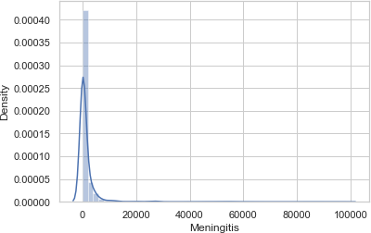
unique | 204 | 30
top | Afghanistan | 1990
freq | 30 | 204
# Check Normality of continous data
for i in df1_cont.columns: sns.distplot(df1_cont[i]) print(kstest(df1_cont[i].values,'norm')) plt.show()
KstestResult(statistic=0.8829688223001868, pvalue=0.0)
KstestResult(statistic=0.9661337620990889, pvalue=0.0)

Slide 17
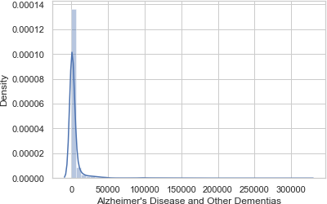
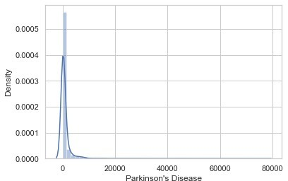
KstestResult(statistic=0.9471795137330757, pvalue=0.0)
KstestResult(statistic=0.8811714366792718, pvalue=0.0)

Slide 18
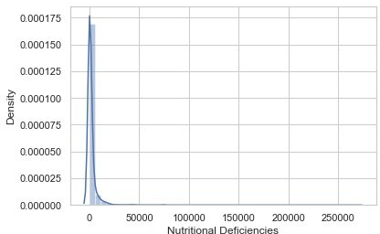
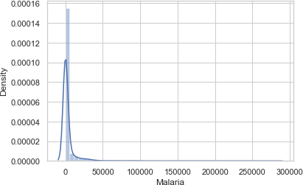
KstestResult(statistic=0.5, pvalue=0.0)
KstestResult(statistic=0.9483233045827489, pvalue=0.0)

Slide 19
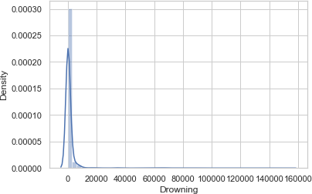
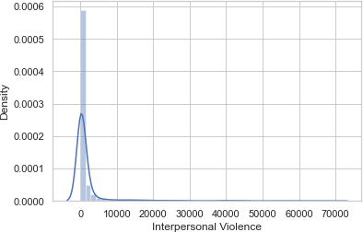
KstestResult(statistic=0.9432579451056248, pvalue=0.0)
KstestResult(statistic=0.8373805870060691, pvalue=0.0)

Slide 20
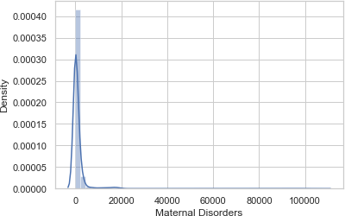
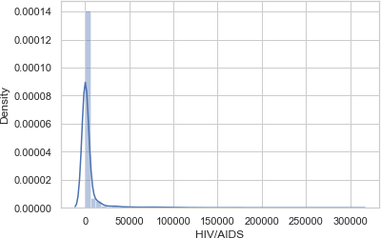
KstestResult(statistic=0.8888511752413633, pvalue=0.0)
KstestResult(statistic=0.7891779726269842, pvalue=0.0)

Slide 21
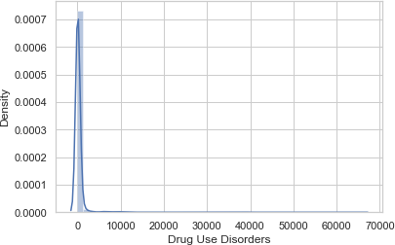
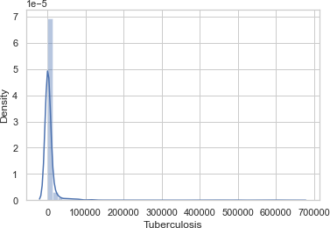
KstestResult(statistic=0.9063298405304614, pvalue=0.0)
KstestResult(statistic=0.9999683287581669, pvalue=0.0)

Slide 22
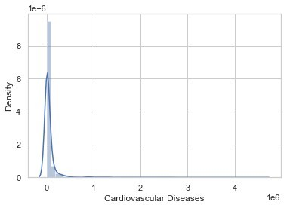
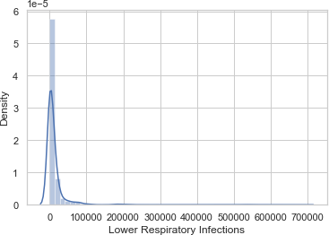
KstestResult(statistic=0.9901644071895395, pvalue=0.0)
KstestResult(statistic=0.9586174222298078, pvalue=0.0)

Slide 23
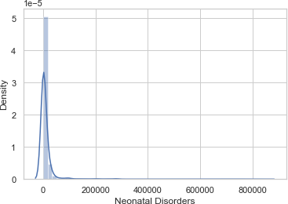
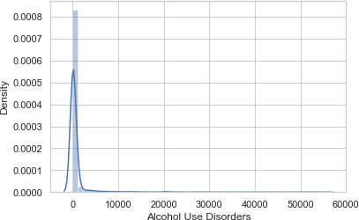
KstestResult(statistic=0.8803544432152195, pvalue=0.0)
KstestResult(statistic=0.967604350334383, pvalue=0.0)

Slide 24
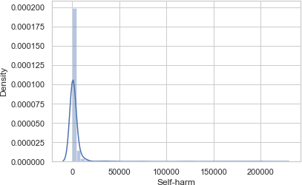
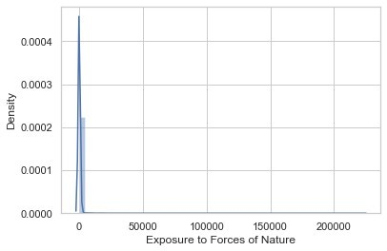
KstestResult(statistic=0.5, pvalue=0.0)
KstestResult(statistic=0.9086224170714287, pvalue=0.0)

Slide 25
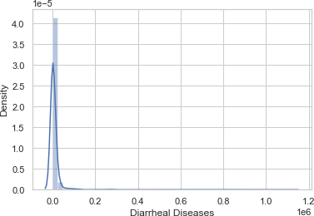
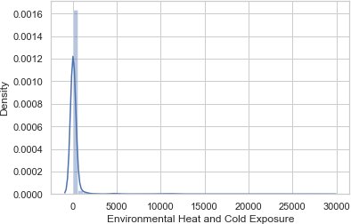
KstestResult(statistic=0.7628707830845005, pvalue=0.0)
KstestResult(statistic=0.9937481411840562, pvalue=0.0)

Slide 26
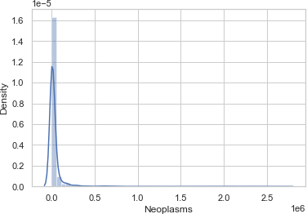
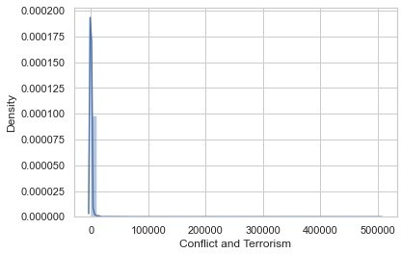
KstestResult(statistic=0.5, pvalue=0.0)
KstestResult(statistic=0.9919507555631412, pvalue=0.0)

Slide 27
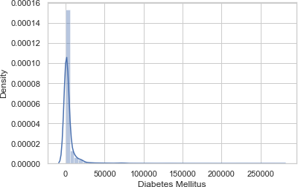
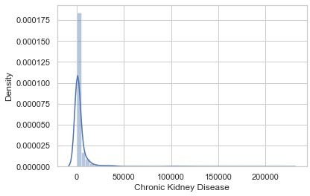
KstestResult(statistic=0.9849246117722915, pvalue=0.0)
KstestResult(statistic=0.8133609791629319, pvalue=0.0)

Slide 28
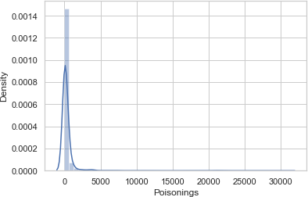
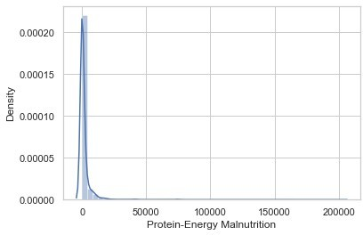
KstestResult(statistic=0.8520864693590103, pvalue=0.0)
KstestResult(statistic=0.9829638274585659, pvalue=0.0)

Slide 29
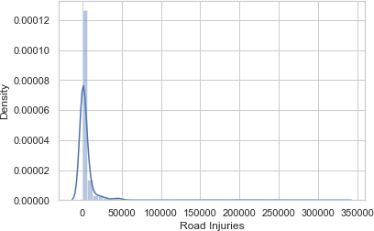
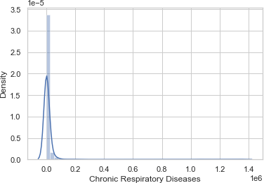
KstestResult(statistic=0.9890206163398663, pvalue=0.0)
KstestResult(statistic=0.9738135006611803, pvalue=0.0)

Slide 30
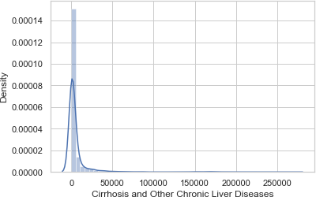
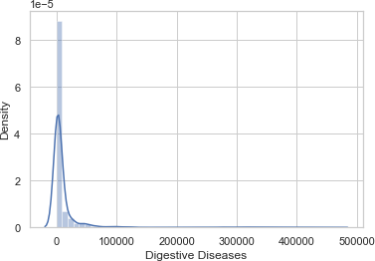
KstestResult(statistic=0.9878657882428797, pvalue=0.0)
KstestResult(statistic=0.895550521646592, pvalue=0.0)

Slide 31
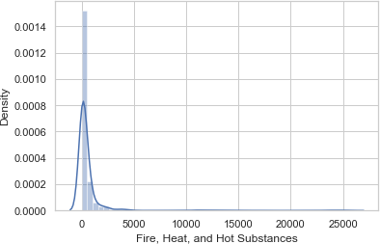
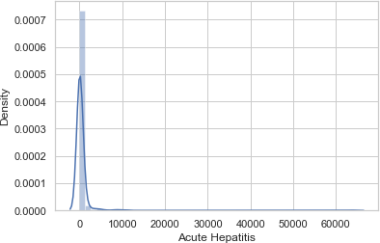
KstestResult(statistic=0.75551784190803, pvalue=0.0)
All of the features are not follow the NDs ( Right Skewed ) as it shown in both graphs and Statistics
df1_cont.skew()

Slide 32
Meningitis
Alzheimer's Disease and Other Dementias Parkinson's Disease
Nutritional Deficiencies Malaria
Drowning
8.248599
8.695288
9.321242
14.863496
9.159105
10.553901
Interpersonal Violence | 5.777146
Maternal Disorders | 12.278358
HIV/AIDS | 6.610169
Drug Use Disorders | 13.367100
Tuberculosis | 12.022406
Cardiovascular Diseases | 9.411914
Lower Respiratory Infections | 9.036604
Neonatal Disorders | 10.447536
Alcohol Use Disorders | 9.253511
Self-harm | 8.973653
Exposure to Forces of Nature | 34.507640
Diarrheal Diseases | 12.563758
Environmental Heat and Cold Exposure | 10.631493
Neoplasms | 10.748333
Conflict and Terrorism | 60.707004
Diabetes Mellitus | 8.022653
Chronic Kidney Disease | 7.919364
Poisonings | 10.929760
Protein-Energy Malnutrition | 13.115196
Road Injuries | 9.466209
Chronic Respiratory Diseases | 10.298131
Cirrhosis and Other Chronic Liver Diseases | 7.764715
Digestive Diseases | 8.026536
Fire, Heat, and Hot Substances | 8.578848
Acute Hepatitis | 12.756098
dtype: float64 df2=df.copy()
# The unique Year data in the Dataframe
df1_cat['Year'].unique()
array([1990, | 1991, | 1992, | 1993, | 1994, | 1995, | 1996, | 1997, 1998, 1999,
2000,
2001, | 2002, | 2003, | 2004, | 2005, | 2006, | 2007, | 2008, 2009, 2010,
2011,
2012, | 2013, | 2014, | 2015, | 2016, | 2017, | 2018, | 2019], dtype=object)
There are 30 years of statistics in this data set (1990-2019).
# Creating a new column for 'Total_no_of_Deaths' for individual Country and Year
df2['Total_no_of_Deaths'] = df2.sum(axis=1)

Slide 33
df2 | Country/Territory |  | Year | Meningitis | \
0 | Afghanistan |  | 1990 | 2159
1 | Afghanistan |  | 1991 | 2218
2 | Afghanistan |  | 1992 | 2475
3 | Afghanistan |  | 1993 | 2812
4 ... 6115 | Afghanistan ... Zimbabwe |  | 1994 ... 2015 | 3027 ... 1439
6116 | Zimbabwe |  | 2016 | 1457
6117 | Zimbabwe |  | 2017 | 1460
6118 | Zimbabwe |  | 2018 | 1450
6119 | Zimbabwe |  | 2019 | 1450
 | Alzheimer's | Disease and |  | Other Dementias |  | Parkinson's Disease |  | \
0 |  |  |  | 1116 |  | 371
1 |  |  |  | 1136 |  | 374
2 |  |  |  | 1162 |  | 378
3 |  |  |  | 1187 |  | 384
4 ... 6115 |  |  |  | 1211 ... 754 |  | 391 ... 215
6116 |  |  |  | 767 |  | 219
6117 |  |  |  | 781 |  | 223
6118 |  |  |  | 795 |  | 227
6119 |  |  |  | 812 |  | 232
Nutritional Violence \ 0 |  | Deficiencies 2087 |  | Malaria 93 | Drowning 1370 |  | Interpersonal
1538
1 |  | 2153 |  | 189 | 1391
2001
2 |  | 2441 |  | 239 | 1514
2299
3 |  | 2837 |  | 108 | 1687
2589
4 |  | 3081 |  | 211 | 1809
2849 ... ... 6115 |  | ... 3019 |  | ... 2518 | ... 770
1302
6116 |  | 3056 |  | 2050 | 801
1342
6117 |  | 2990 |  | 2116 | 818
1363
6118 |  | 2918 |  | 2088 | 825
1396

Slide 34
6119
1434
2884
2068
827
Maternal Disorders HIV/AIDS Drug Use Disorders Tuberculosis \
0 | 2655 |  | 34 |  | 93 |  | 4661
1 | 2885 |  | 41 |  | 102 |  | 4743
2 | 3315 |  | 48 |  | 118 |  | 4976
3 | 3671 |  | 56 |  | 132 |  | 5254
4 | 3863 |  | 63 |  | 142 |  | 5470
... | ... |  | ... |  | ... |  | ...
6115 | 1355 |  | 29162 |  | 104 |  | 11214
6116 | 1338 |  | 27141 |  | 110 |  | 10998
6117 | 1312 |  | 24846 |  | 115 |  | 10762
6118 | 1294 |  | 22106 |  | 121 |  | 10545
6119 | 1294 |  | 20722 |  | 127 |  | 10465
 | Cardiovascular Diseases |  | Lower |  | Respiratory | Infections | \
0 | 44899 |  |  |  |  | 23741
1 | 45492 |  |  |  |  | 24504
2 | 46557 |  |  |  |  | 27404
3 | 47951 |  |  |  |  | 31116
4 ... 6115 | 49308 ... 16649 |  |  |  |  | 33390 ... 12974
6116 | 16937 |  |  |  |  | 13024
6117 | 17187 |  |  |  |  | 12961
6118 | 17460 |  |  |  |  | 12860
6119 | 17810 |  |  |  |  | 12897
 | Neonatal Disorders | Alcohol |  | Use Disorders |  | Self-harm | \
0 | 15612 |  |  | 72 |  | 696
1 | 17128 |  |  | 75 |  | 751
2 | 20060 |  |  | 80 |  | 855
3 | 22335 |  |  | 85 |  | 943
4 ... 6115 | 23288 ... 9278 |  |  | 88 ... 48 |  | 993 ... 2235

Slide 35
6116 | 9065 |  |  |  | 49 |  |  |  | 2296
6117 | 8901 |  |  |  | 50 |  |  |  | 2338
6118 | 8697 |  |  |  | 51 |  |  |  | 2372
6119 | 8609 |  |  |  | 53 |  |  |  | 2403
 | Exposure | to | Forces |  | of | Nature | Diarrheal Diseases |  | \
0 |  |  |  |  |  | 0 | 4235
1 |  |  |  |  |  | 1347 | 4927
2 |  |  |  |  |  | 614 | 6123
3 |  |  |  |  |  | 225 | 8174
4 ... 6115 |  |  |  |  |  | 160 ... 16 | 8215 ... 5102
6116 |  |  |  |  |  | 31 | 5002
6117 |  |  |  |  |  | 251 | 4948
6118 |  |  |  |  |  | 0 | 4745
6119 |  |  |  |  |  | 660 | 4635
Environmental Terrorism \ 0 |  |  |  | Heat | and | Cold | Exposure 175 | Neoplasms 11580 | Conflict | and
1490
1 |  |  |  |  |  |  | 113 | 11796
3370
2 |  |  |  |  |  |  | 38 | 12218
4344
3 |  |  |  |  |  |  | 41 | 12634
4096
4 |  |  |  |  |  |  | 44 | 12914
8959 ... ... 6115 |  |  |  |  |  |  | ... 37 | ... 11161
13
6116 |  |  |  |  |  |  | 37 | 11465
6
6117 |  |  |  |  |  |  | 37 | 11744
5
6118 |  |  |  |  |  |  | 37 | 12038
9
6119 |  |  |  |  |  |  | 37 | 12353
11
 | Diabetes Mellitus | Chronic Kidney Disease | Poisonings | \
0 | 2108 | 3709 | 338
1 | 2120 | 3724 | 351
2 | 2153 | 3776 | 386
3 | 2195 | 3862 | 425
4 | 2231 | 3932 | 451
... | ... | ... | ...

Slide 36
6115 | 3176 |  | 2108 |  | 381
6116 | 3259 |  | 2160 |  | 393
6117 | 3313 |  | 2196 |  | 398
6118 | 3381 |  | 2240 |  | 400
6119 | 3460 |  | 2292 |  | 405
 | Protein-Energy Malnutrition |  | Road | Injuries | \
0 | 2054 |  |  | 4154
1 | 2119 |  |  | 4472
2 | 2404 |  |  | 5106
3 | 2797 |  |  | 5681
4 ... 6115 | 3038 ... 2990 |  |  | 6001 ... 2373
6116 | 3027 |  |  | 2436
6117 | 2962 |  |  | 2473
6118 | 2890 |  |  | 2509
6119 | 2855 |  |  | 2554
Chronic Respiratory |  | Diseases | \
0 |  | 5945
1 |  | 6050
2 |  | 6223
3 |  | 6445
4 ... 6115 |  | 6664 ... 2751
6116 |  | 2788
6117 |  | 2818
6118 |  | 2849
6119 |  | 2891
Cirrhosis and Other Diseases \ 0 |  | Chronic | Liver | Diseases 2673 | Digestive | 5005
1 |  |  |  | 2728 |  | 5120
2 |  |  |  | 2830 |  | 5335
3 |  |  |  | 2943 |  | 5568
4 |  |  |  | 3027 |  | 5739
... |  |  |  | ... |  | ...
6115 |  |  |  | 1956 |  | 4202
6116 |  |  |  | 1962 |  | 4264

Slide 37
6117 | 2007 |  |  |  | 4342
6118 | 2030 |  |  |  | 4377
6119 | 2065 |  |  |  | 4437
Fire, Heat, and Total_no_of_Deaths 0 | Hot | Substances 323 | Acute | Hepatitis 2985
147971
1 |  | 332 |  | 3092
156844
2 |  | 360 |  | 3325
169156
3 |  | 396 |  | 3601
182230
4 |  | 420 |  | 3816
194795 ... ... 6115 |  | ... 632 |  | ... 146
130080
6116 |  | 648 |  | 146
128274
6117 |  | 654 |  | 144
126515
6118 |  | 657 |  | 139
123506
6119 |  | 662 |  | 136
123540
[6120 rows x 34 columns]
EDA
Univariate analysis
text = " ".join(subject_titles for subject_titles in
df1_cat["Country/Territory"])
wordcloud = WordCloud(width = 800, height = 250, background_color
="black",colormap="RdYlGn",max_font_size=100, stopwords =None,repeat= True).generate(text)
plt.figure(figsize = (20, 8),facecolor= "#254441") plt.imshow(wordcloud)
plt.axis("off") plt.margins(x=0, y=0)

Slide 38
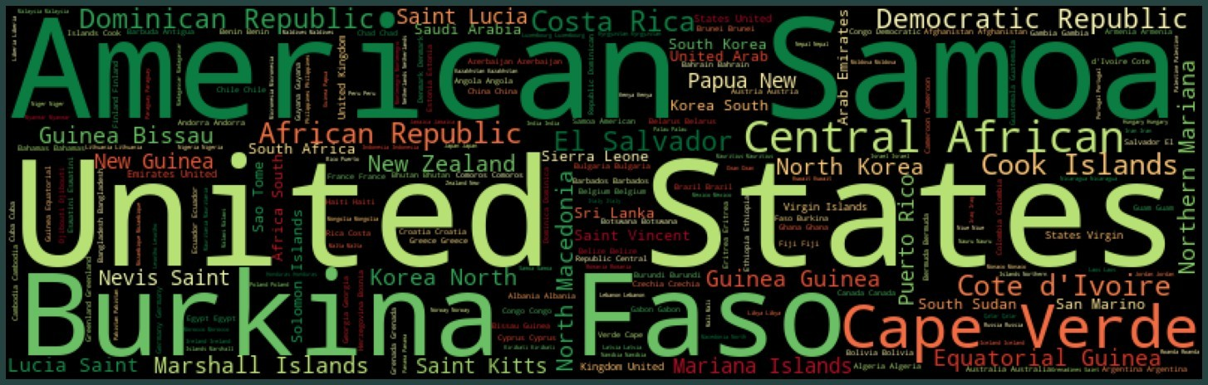
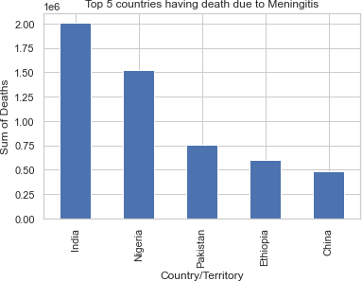
plt.tight_layout(pad = 0) plt.show()
Bivariate analysis
for i in df1_cont.columns: df2.groupby('Country/Territory')
[i].sum().sort_values(ascending=False).head().plot(kind='bar') plt.title('Top 5 countries having death due to '+i) plt.ylabel('Sum of Deaths')
plt.show()

Slide 39
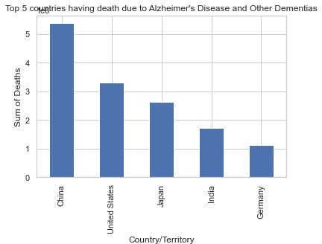

Slide 40
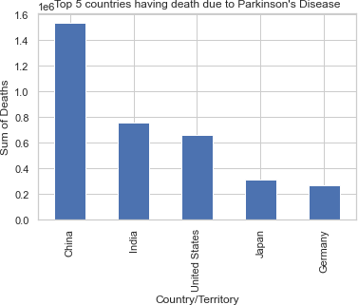

Slide 41
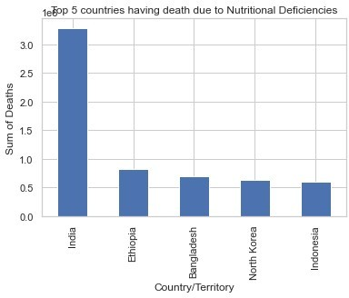

Slide 42
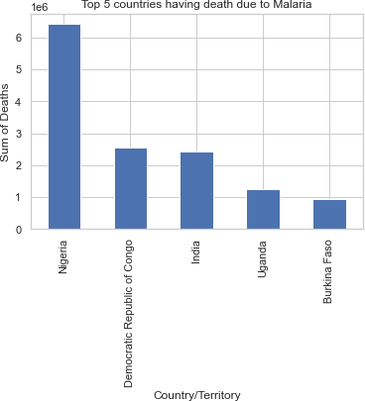

Slide 43
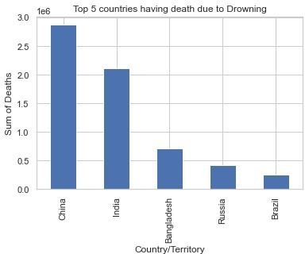

Slide 44
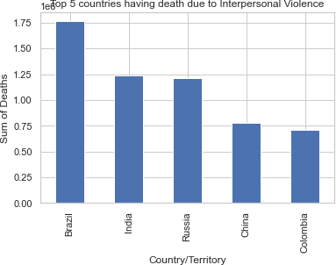
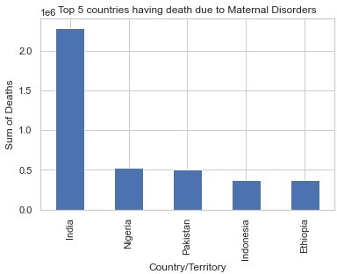

Slide 45
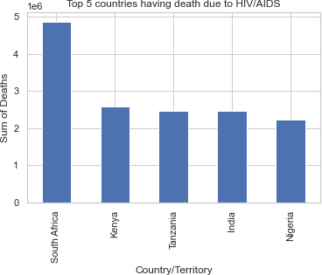

Slide 46
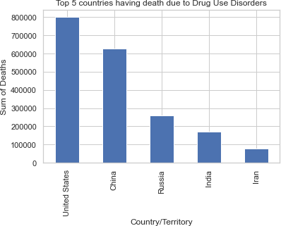

Slide 47
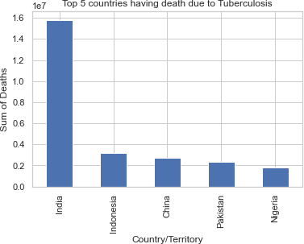

Slide 48
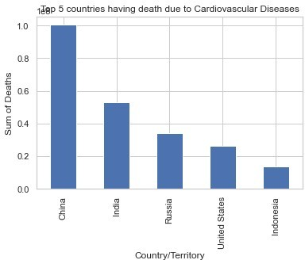

Slide 49
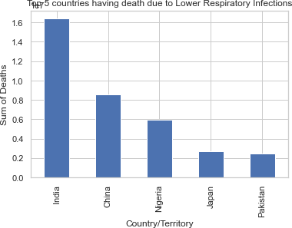
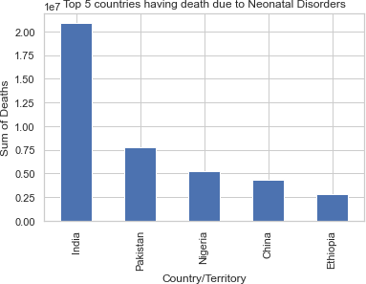

Slide 50
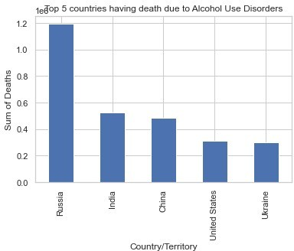

Slide 51
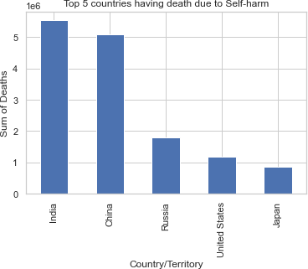

Slide 52
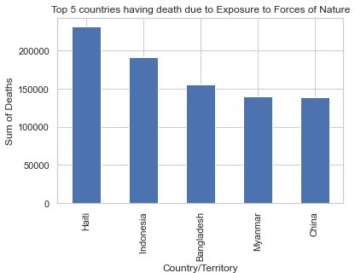

Slide 53
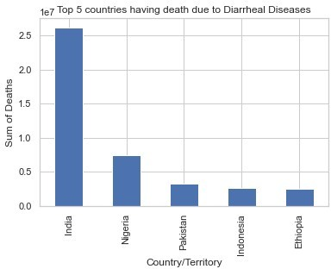


Slide 54


Slide 55


Slide 56


Slide 57


Slide 58



Slide 59


Slide 60


Slide 61


Slide 62


Slide 63


Slide 64

# Top countries in different death disease/enviroment from above graphs
# India---- Meningits, Nutritional Deficiencies, Maternal Disorders,
Tuberculosis, Lower Respiratory Infections, Self-harm
# Neonatal Disorders,Diarrheal Diseases, Diabetes Mellitus,Choronic kidney,Protein-energy malnutrition,Digestive,Acute Hepatitis
# Cirrhosis & other chronic liver, Fire/heat & hot substances
# China---- Alzheimer, Parkinson, Drowning, Cardiovascular Diseases,
Neoplasms, Poisonings, Road injuries, Chronic respiratory # Nigeria---- Malaria
# Brazil---- Interpersonal Violence # South Africa---- HIV/AIDS
# USA---- Drug use Disorders
# Russia---- Alcohol use Disorders, Environmental Heat&cold exposure # Haiti---- Exposure to forces of nature
# Rwanda---- Conflict & Terrorism
df2.groupby('Country/Territory') ['Total_no_of_Deaths'].sum().sort_values(ascending=False).head().plot( kind='barh')
plt.show()
<AxesSubplot:ylabel='Country/Territory'>

Slide 65

# Divide the causes of death into 3 main categories:
communicable_diseases_df = df2[["Year", "Nutritional Deficiencies", "Malaria", "Maternal Disorders", "HIV/AIDS","Drug Use Disorders","Tuberculosis","Neonatal Disorders","Alcohol Use Disorders","Diarrheal Diseases"]]
non_communicable_diseases_df = df2[["Year", "Meningitis","Alzheimer's Disease and Other Dementias", "Parkinson's Disease",
"Cardiovascular Diseases","Lower Respiratory Infections", "Acute Hepatitis", "Digestive Diseases", "Cirrhosis and Other Chronic Liver Diseases",
"Chronic Respiratory Diseases", "Diabetes Mellitus","Chronic Kidney Disease"]]
injures_df = df2[["Year","Drowning", "Interpersonal Violence", "Fire, Heat, and Hot Substances", "Road Injuries", "Poisonings" ,
"Protein-Energy Malnutrition", "Conflict and Terrorism", "Self-harm", "Exposure to Forces of Nature",
"Environmental Heat and Cold Exposure"]]
communicable_diseases_df = df.assign(sumRow = communicable_diseases_df.sum(axis=1) - communicable_diseases_df['Year']) sum_by_year_communicable_diseases_df =
communicable_diseases_df[['Year','sumRow']].groupby('Year').sum().rese t_index(drop=False)

Slide 66
non_communicable_diseases_df = non_communicable_diseases_df.assign(sumRow = non_communicable_diseases_df.sum(axis=1) - non_communicable_diseases_df['Year']) sum_by_year_non_communicable_diseases_df = non_communicable_diseases_df[['Year','sumRow']].groupby('Year').sum(). reset_index(drop=False)
injures_df = injures_df.assign(sumRow = injures_df.sum(axis=1) - injures_df['Year'])
sum_by_year_injures_df = injures_df[['Year','sumRow']].groupby('Year').sum().reset_index(drop=F alse)
sum_by_year_df = sum_by_year_communicable_diseases_df.merge(sum_by_year_non_communicabl e_diseases_df, on='Year').merge(sum_by_year_injures_df,on='Year') sum_by_year_df.rename(columns={'sumRow_x': 'communicable_diseases', 'sumRow_y': 'non_communicable_diseases', 'sumRow': 'injures'}, inplace=True)
# "Total_no_of_Deaths" against "Year"
sum_by_year_df["Total"]=sum_by_year_df["communicable_diseases"]
+sum_by_year_df["non_communicable_diseases"]+sum_by_year_df["injures"] plt.subplots(figsize=(20,8))
p=sns.lineplot(x=sum_by_year_df["Year"] ,y=sum_by_year_df["Total"],dat a=sum_by_year_df,color="#11264e",marker="o",linewidth=3,markersize=10, markerfacecolor="orange",markeredgecolor="black",markeredgewidth=3) p.axes.set_title("\n Change in the number of deaths worldwide 1990- 2019\n",fontsize=25)
p.axes.set_xlabel("\nYear",fontsize=20) p.axes.set_ylabel("Total number of deaths",fontsize=20)
sns.despine(left=True, bottom=True) plt.show()

Slide 67

# China - "Total_no_of_Deaths" against "Year"
China_Total_no_of_Deaths = df2[df2['Country/Territory']=='China'].sort_values(by='Total_no_of_Dea ths',ascending=False)
plt.figure(figsize=(8,4),dpi=200) sns.scatterplot(data=China_Total_no_of_Deaths, x='Year', y='Total_no_of_Deaths')
plt.xlabel("Year") plt.ylabel("Total no.of Deaths")
plt.title("Year Vs. Total no.of Deaths for China") plt.show();

Slide 68

# Cancer Neoplasms=pd.DataFrame(df2.groupby("Year") ["Neoplasms"].sum()).reset_index() plt.subplots(figsize=(20,8))
sns.set(rc={"axes.facecolor":"#F2EAC5","figure.facecolor":"#D8D5A6"})
p=sns.lineplot(x=Neoplasms["Year"],
y=Neoplasms["Neoplasms"], data=Neoplasms, color="#2540D5",
marker="o",linewidth=3,markersize=10,
markerfacecolor="orange",markeredgecolor="red",markeredgewidth=3) p.axes.set_title("\nNumber of deaths from Neoplasms by year\ n",fontsize=25)
p.axes.set_xlabel("\nYear",fontsize=20) p.axes.set_ylabel("Total",fontsize=20);

Slide 69

# Conflict/Terrorism Conflict_Terrorism=pd.DataFrame(df2.groupby("Year")["Conflict and Terrorism"].sum()).reset_index()
plt.subplots(figsize=(20,8))
p=sns.lineplot(x=Conflict_Terrorism["Year"],
y=Conflict_Terrorism["Conflict and Terrorism"], data=Conflict_Terrorism,
color="#2540D5", marker="o",linewidth=3,markersize=10,
markerfacecolor="orange",markeredgecolor="red",markeredgewidth=3) p.axes.set_title("\nNumber of deaths from Conflict and Terrorism by year\n",fontsize=25)
p.axes.set_xlabel("\nYear",fontsize=20) p.axes.set_ylabel("Total",fontsize=20)
sns.despine(left=True, bottom=True) plt.show()

Slide 70

temp=pd.DataFrame(df2.groupby("Year")["Conflict and Terrorism"]).reset_index() temp=df2[df2["Year"]==1994].sort_values(['Conflict and Terrorism'],ascending=False)
plt.subplots(figsize=(20,8))
p = sns.barplot(x=temp["Country/Territory"][:5],y=temp["Conflict and Terrorism"], saturation=1,edgecolor = "#1c1c1c", linewidth = 3) p.axes.set_title("\nCountries/territories with the highest number of deaths from Conflict and Terrorism 1994\n",fontsize=25) plt.xlabel("\nCountry/Territory",fontsize=20) plt.ylabel("Total",fontsize=20)
plt.xticks(rotation=0)
for container in p.containers:
p.bar_label(container,label_type="edge",padding=2,size=18,color="black ",rotation=0,
bbox={"boxstyle": "round", "pad": 0.6, "facecolor": "orange",
"edgecolor": "#1c1c1c", "linewidth" : 3, "alpha": 1})
sns.despine(left=True, bottom=True) plt.show()

Slide 71

# Number of deaths from Tuberculosis by year Tuberculosis=pd.DataFrame(df2.groupby("Year") ["Tuberculosis"].sum()).reset_index() plt.subplots(figsize=(20,8))
p=sns.lineplot(x=Tuberculosis["Year"],
y=Tuberculosis["Tuberculosis"], data=Tuberculosis, color="#2540D5",
marker="o",linewidth=3,markersize=10,
markerfacecolor="orange",markeredgecolor="red",markeredgewidth=3) p.axes.set_title("\nNumber of deaths from Tuberculosis by year\ n",fontsize=25)
p.axes.set_xlabel("\nYear",fontsize=20) p.axes.set_ylabel("Total",fontsize=20)
sns.despine(left=True, bottom=True) plt.show()

Slide 72

# HIV/AIDS
HIV_AIDS=pd.DataFrame(df2.groupby("Year")["HIV/AIDS"].sum()).reset_ind ex()
plt.subplots(figsize=(20,8))
p=sns.lineplot(x=HIV_AIDS["Year"],
y=HIV_AIDS["HIV/AIDS"],
data=HIV_AIDS, color="#2540D5",
marker="o",linewidth=3,markersize=10,
markerfacecolor="orange",markeredgecolor="red",markeredgewidth=3) p.axes.set_title("\nNumber of deaths from HIV/AIDS by year\ n",fontsize=25)
p.axes.set_xlabel("\nYear",fontsize=20) p.axes.set_ylabel("Total",fontsize=20)
sns.despine(left=True, bottom=True) plt.show()

Slide 73


# Check correlation
plt.figure(figsize = (200,70)) sns.heatmap(df2.corr(),
annot=True,cmap='summer',mask=np.triu(np.ones_like(df2.corr()))) plt.show()

